Slide 1
.NET of Things

Slide 2
This is:
This isn’t:
100 Level Overview
.NET
Electronics
Native C/C++
Anything Internet related

Slide 3
Word Cloud
C#
.NET Core
.NET Standard
UWP
Micro Controller Unit (MCU)
Gadgeteer
.NET MicroFramework
TinyCLR OS
Meadow

Slide 4
Misc Tools You’ll Need
SD Card Formatter
Disk Imager
Win32 Disk Imager
Windows 10 IoT Core Dashboard
Plus your normal .NET Coding Tools

Slide 5

Demo App
Based on outside light
Turn spaceship lights on or off
Constantly polling light sensor
Polling over I²C protocol

Slide 6
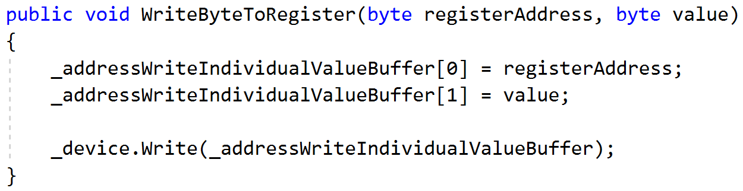
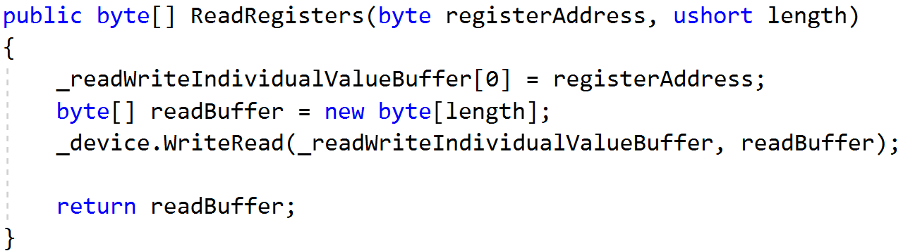
I²C Protocol
Eye Squared See
Synchronous Protocol
Requires Hardware Support
Message Process
Writing Data
Write Out Register
Write Out Each Byte
Reading Data
Write Out Register
Read Each Byte

Slide 7
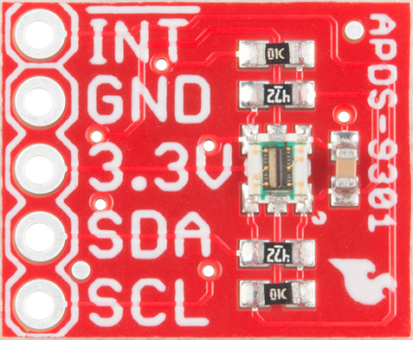
SparkFun Ambient Light Sensor
APDS-9301
https://www.sparkfun.com/products/14350

Slide 8
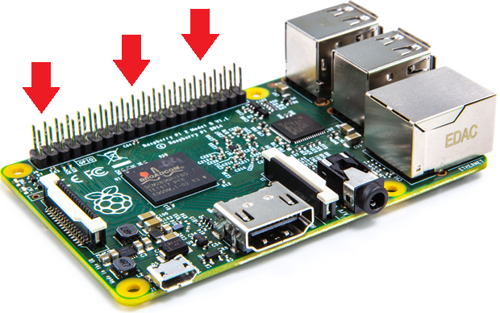
Raspberry Pi
“Low Resources”
1.4 GHz 64 bit ARM CPU
1 GB RAM
Pi 3 B+
Exposed Pins
The Money Maker

Slide 9
Three Options with .NET
Windows 10 IoT
Mono on Raspberry Pi
.NET Core on Raspberry Pi

Slide 10
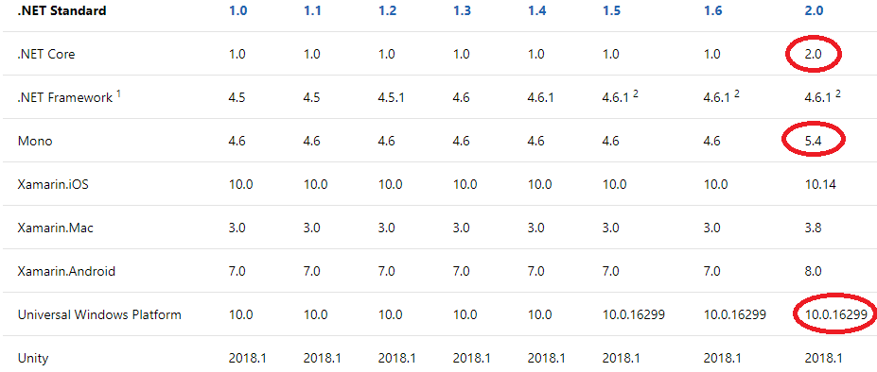
.NET Standard 2.0+ Benefits

Slide 11
Windows 10 IoT
Version of Windows for non-general purpose devices

Slide 12
Good
Ugly
Amazing tooling
Top Tier Debugging
Line-by-Line
Remote over network
Familiar to Windows Devs
Remote PowerShell, Command Line
Required OS updates every few years
Enterprise Programming Model
Service vs. Client vs. Full App
Headed vs. Headless
Hardware Specific
Doesn’t run on MCUs
No quick start to creating a new App
Copy/Paste existing examples

Slide 13
Headed vs. Headless
Headed:
Has a UI
Single app starts on device startup
Headless:
No UI
UI Stack is disabled
Black screen when monitor attached

Slide 14
IoT Dashboard
Handles downloading Windows Versions
Puts Windows IoT onto SD Cards
Remotely connects to IoT Devices
Run commands

Slide 15
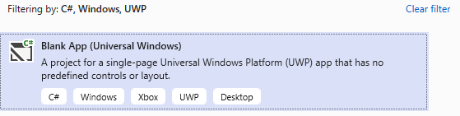
Windows 10 IoT - Getting Setup
Download/Install IoT Core Dashboard
https://docs.microsoft.com/en-us/windows/iot-core/downloads
Create New Project in VS
Blank App (Universal Windows)
Manually make some changes
Debug Remotely
VS can find the target device

Slide 16
Demo

Slide 17
.NET on Raspberry Pi
Running on Linux
Mono vs .NET Core (Pre/Post 3.0)

Slide 18
Good
Mono
Ugly
Access to all Linux tools you’re used to
Mono tools not in .NET Core
Compile on-board
AOT Compiling
.NET Standard
On-board debugging
Installed with apt-get
Windows/MacOS/Linux Support
Doesn’t get as much love as Core

Slide 19
Good
.NET Core
Ugly
Remote Debugging Exists
Access to all Linux tools you’re used to
GPIO Support for Raspberry Pi in .NET Core 3.0
Installed with apt-get, or downloading
With Snap for 3.0
Windows/MacOS/Linux Support
Remote Debugging is Slow
Can’t compile on ARM chips

Slide 20
Pin Access
File API
Linux loves File APIs
Not available for all pins like I²C
P/Invoke
For performance
Requires low-level code

Slide 21
Setting Up I²C Raspberry Pi
Not on by default
Run `<>` to run through setup
https://learn.sparkfun.com/tutorials/raspberry-pi-spi-and-i2c-tutorial/all

Slide 22
WiringPi
Open Source library for working with pins on Raspberry Pi
Can compile yourself
Do it on Raspberry Pi
http://wiringpi.com/download-and-install/

Slide 23
Compiling Apps
.NET Core
Specify `linux-arm` architecture
Self Contained if you desire
Can’t be done on ARM device
`dotnet publish ./RaspbianNetCoreDemo -c Release -r linux-arm --self-contained`
~\bin\Release\netcoreapp3.0\linux-arm\publish
`dotnet RaspbianNetCoreDemo .dll`
Mono
Can be done on ARM device
Compile with MonoDevelop on Linux
`mono RaspbianNetCoreDemo.exe`

Slide 24
New in .NET Core 3.0
ARM 64 support for Linux
Not Windows Yet
Pin Bindings for Raspberry Pi
Open Source at github.com/dotnet/iot
Installed with Snap
An app package manager
sudo apt install snapd
sudo snap install dotnet-sdk --beta --classic

Slide 25
Demo

Slide 26
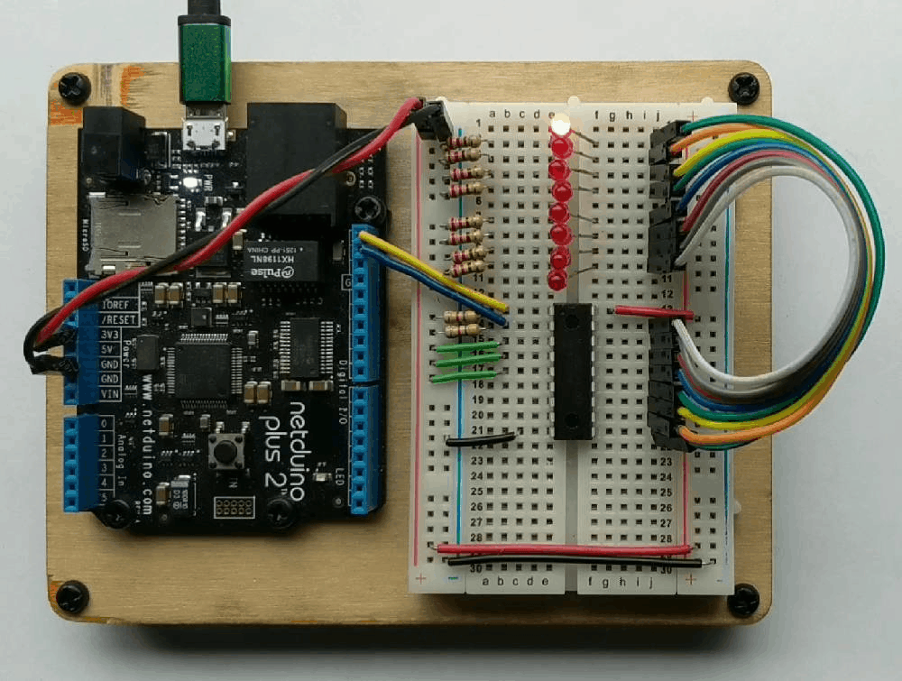
History Lesson - .NET MicroFramework
Legacy
Designed for MCUs
RAM ~300KB
CPU like Cortex-M3 @ 120 MHz
Limited in features
No generics
Limited MCU selection
Open Source
http://netmf.github.io/
Netduino 2 courtesy of https://www.wildernesslabs.co/

Slide 27
Cons
Limited Language Feature Support
No Generics
Required VS Extension to begin
Only worked on Community Version of VS
Maxed out at VS 2015

Slide 28
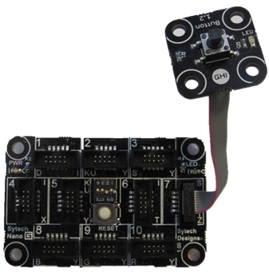
Gadgeteer
Extension of .NET MicroFramework
Easy Prototyping Platform
Expensive
Open Source
https://archive.codeplex.com/?p=gadgeteer
GHIElectronics FEZ Hydra
with Button module

Slide 29
TinyCLR OS
Created by GHI Electronics
https://www.ghielectronics.com/tinyclr/features
Can be ported to custom hardware
Modules hosted on NuGet
Not open source
Though documentation is
Supports native C/C++ code
No Generics Support

Slide 30
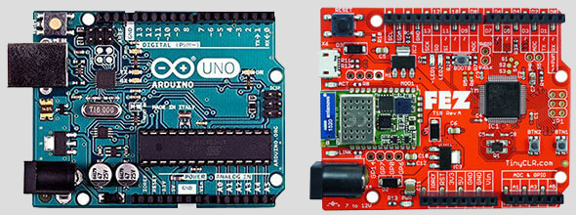
FEZ Board
Fast and Easy
Arduino Pin Compatible
$10 – Lowest Price
ARM Cortex-M4
512 KByte flash
96 KByte SRAM

Slide 31
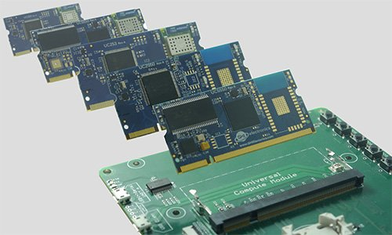
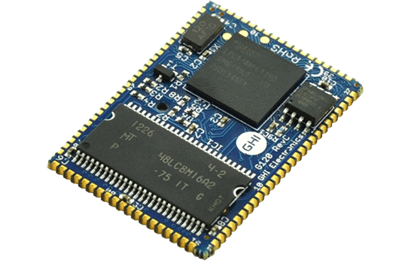
Other GHI Boards/Offerings
Universal Compute Modules
Meant for Prototyping or low volume devices
Switch out module while working
SurfaceMount Compute Modules
Modules solder to board
84MHz to 400 MHz chips
UCM
G120 SCM

Slide 32
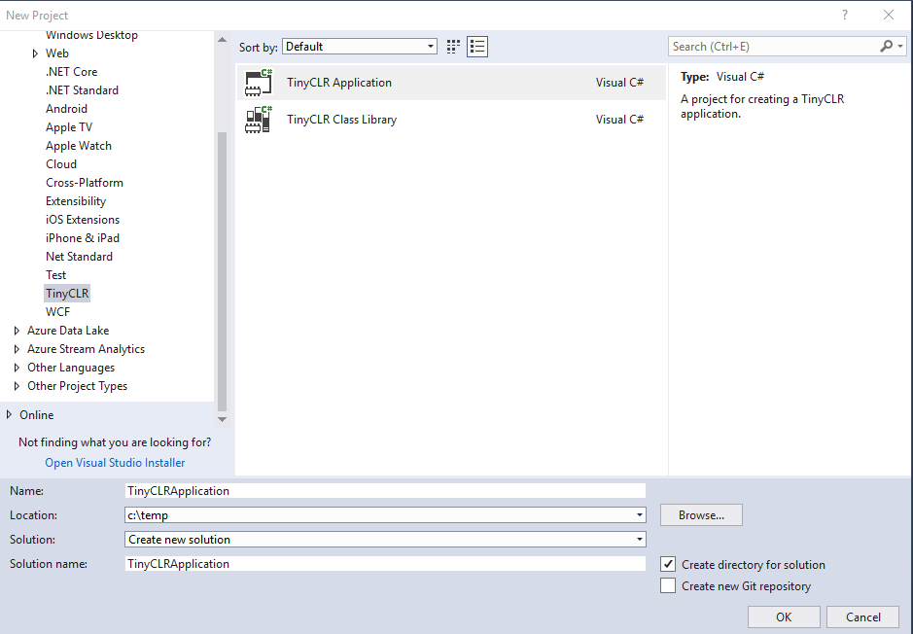
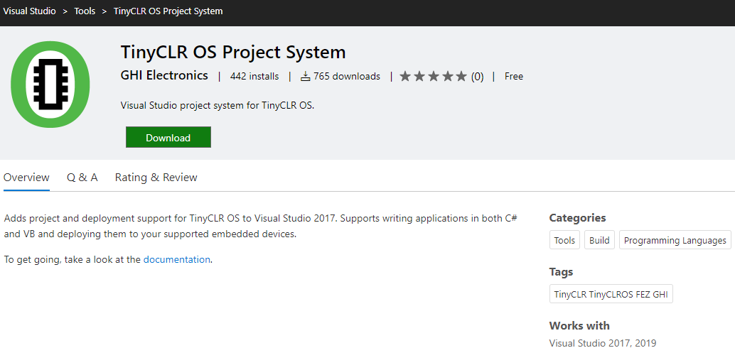
TinyCLR OS – Getting Setup
Follow simple instructions online
https://docs.ghielectronics.com/software/tinyclr/getting-started.html
Install “TinyCLR OS Project System” Extension to VS
https://marketplace.visualstudio.com/items?itemName=ghielectronics.tinyclr-projectsystem
Create new project

Slide 33
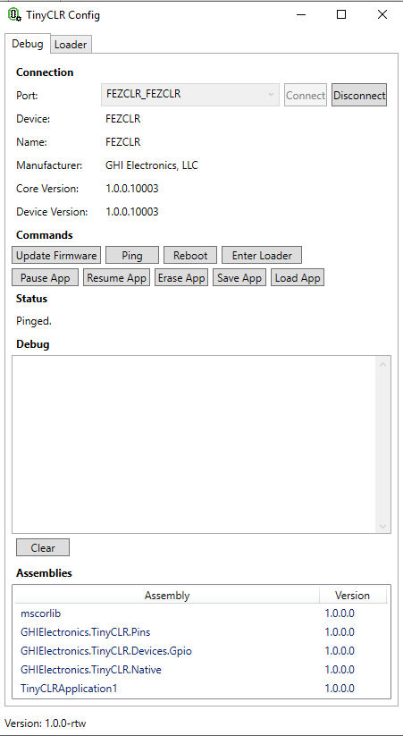
TinyCLR Config
Application to update device Firmware
Debug board
Might need this on first use of new board

Slide 34
Good
Ugly
NuGet Packages
Line-by-Line Debugging
Copies Win10 IoT API
No Generics Support
Can’t reference .NET Standard Libraries
Use Threads, not Tasks
Closed Source

Slide 35
Demo

Slide 36
Meadow Board
Created by Wilderness Labs
.NET 2.0
Runs on top of Mono Runtime
No Board -> No Demo
Documentation: beta-developer.wildernesslabs.co
Very Early Days

Slide 37
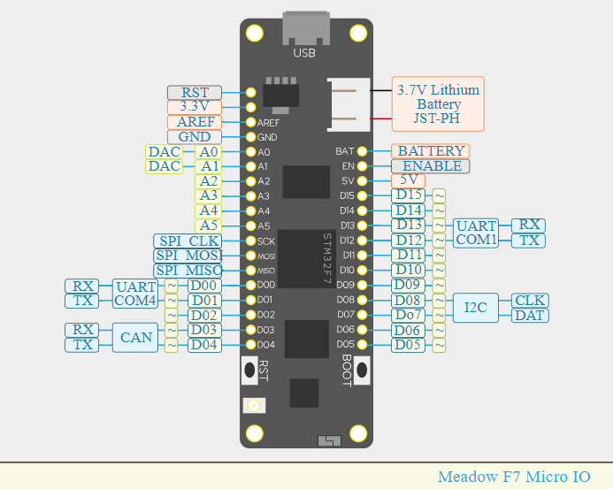

Slide 38
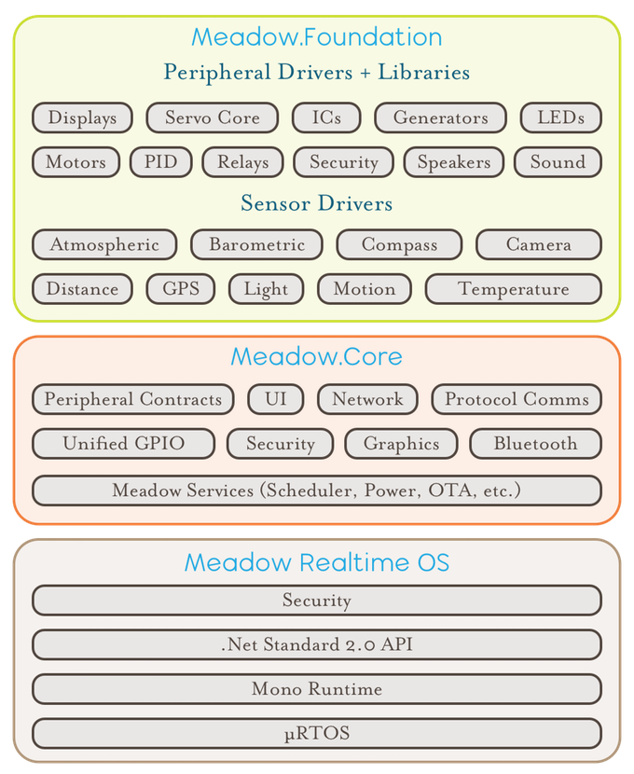

Slide 39
Good
Ugly
NuGet Packages
Line-by-Line Debugging
Windows/MacOS/Linux Support
Very early days
Beta product
Connecting over Vagrant VM is very different
Creating .NET Framework App/DLLs feels off

Slide 40
Getting Setup - Dev Machine - Windows
Follow Instructions per OS
Windows, Linux, and MacOS
Install VirtualBox
Install Vagrant
dfu-uti*
Used to send Meadow OS and/or Your App to Meadow board
* This util comes with Vagrant setup. Download to your OS if you want to
Downloads Link
http://beta-developer.wildernesslabs.co/guides/Getting_Started/Downloads/index.html

Slide 41
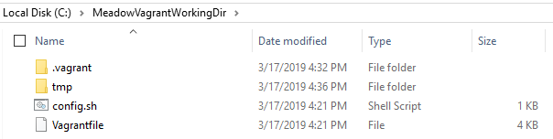
Setup Vagrant
VM software for development machines
After installing, create a Working Folder
Download custom Vagrant file and config.sh from Wilderness Labs
Copy/Paste Vagrantfile and config.sh to Working Folder
From command line, run `vagrant up` to initialize the space

Slide 42
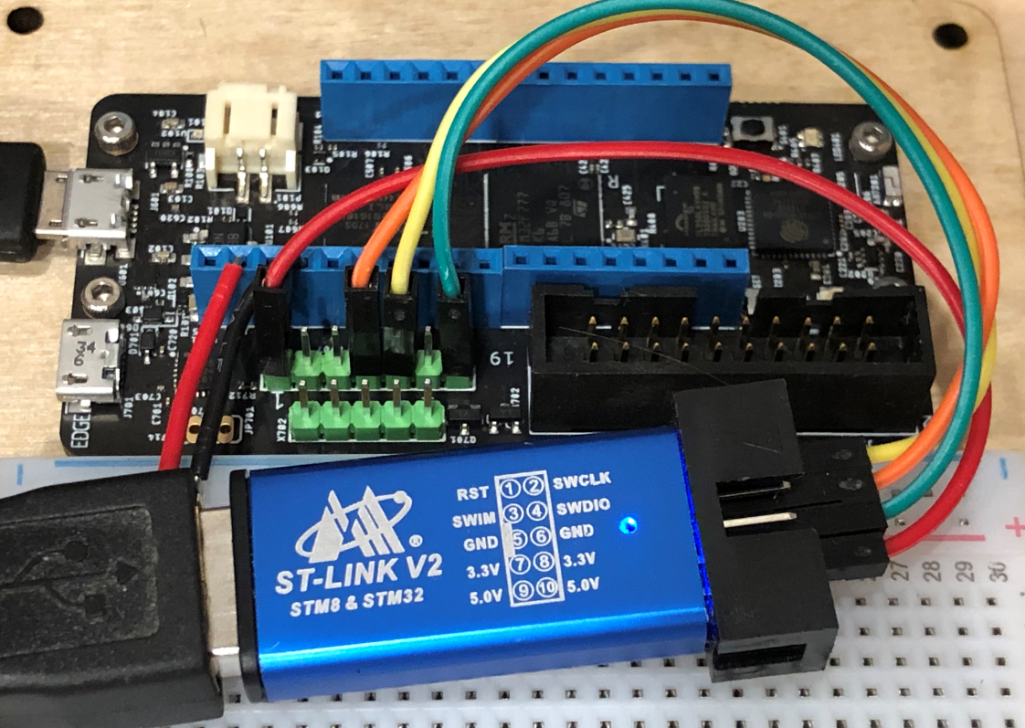
Getting Board Setup
Purchase ST-Link V2
For connecting Meadow board to host computer over USB
Download ST-Link software
Download dfu-util
Device Firmware Upgrade Utilities
Flash Meadow Board with dfu-util

Slide 43
Writing a Meadow App in VS
Create new Console App
.NET Framework 4.7.1
Same on MacOS, just extra steps
Add the Meadow.Core NuGet package
Change assembly name to app
Meadow OS is hard coded to only run ‘app.exe’
Not sure if this is temporary
Create any Class Libraries as .NET Framework
Not Standard

Slide 44
Deploying to/Running On a Meadow Board
Copy/Paste files from /bin to the ~/tmp folder in your Vagrant working folder
Start Vagrant VM
Connect ST-Link to Meadow
Within Vagrant, verify connection to Meadow with `lusb` command
Run `./start.sh &`
Start GDB with `gdb` command
At prompt, enter `target remote :4242`
Enter `c` to start your app.exe

Slide 45
Demo

Slide 46
Extras
Hastlayer
C# on FPGA
Open Source
https://hastlayer.com

